Slide 1
Churn modelling
A Machine Learning Project

Slide 2
ABOUt dataset (Churn modelling)
The dataset is from a telecom company which is trying to predict it churns in the near future and reduce their count.
Churn = Anyone who wants halt/stop the services of a firm/company.
This depends on various factors like tenure, age, marital status etc. So, here we are going to predict the churns beforehand and find a solution to reduce them.

Slide 3
Features: 16
Gender
Seniorcitizen
Partner
Dependents
Tenure
PhoneService
MultipleLines
OnlineSecurity
OnlineBackup
DeviceProtection
TechSupport
StreamingTV
StreamingMovies
Contact
PaperlessBilling
MonthlyCharges

Slide 4
class
Binary(0,1)
Churn is the class attribute.
Churn=1 means he/she is leaving the firm.
Churn=0 means he/she isn’t leaving the firm

Slide 5
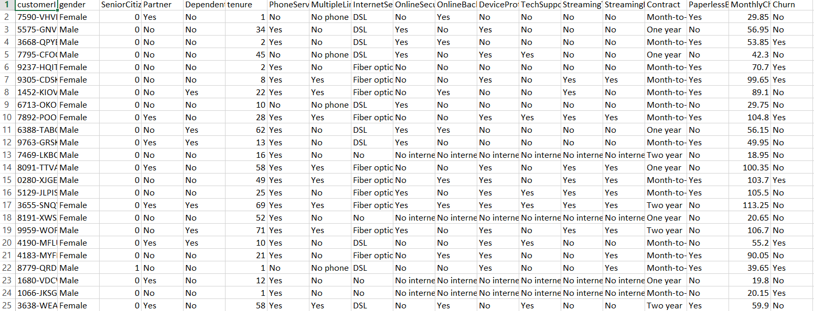
Data.shape = (7043,17)

Slide 6
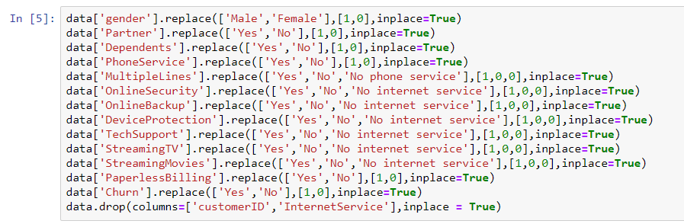
Preprocessing

Slide 7
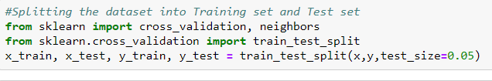
Splitting
Test size = 0.05 i.e., 5%
Training set is 95% i.e., 6,690
Test set is 5% i.e., 353

Slide 8
classifications
KNN
Naïve Bayes
SVM
Logistic Regression
Decision Tree
Random Forest

Slide 9
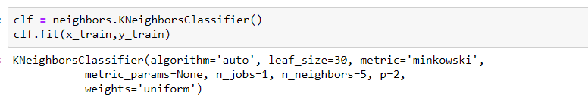
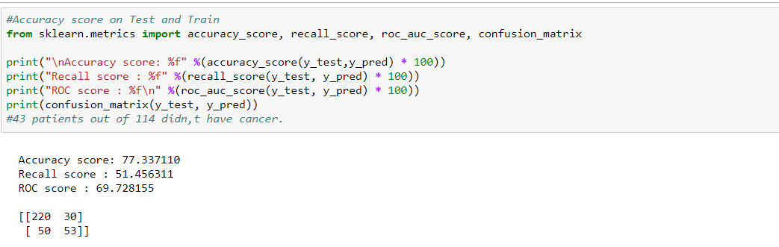
KNN
K-nearest neighbours algorithm is a non-parametric method used for classification and regression. In both cases, the input consists of the k closest training examples in the feature space.

Slide 10
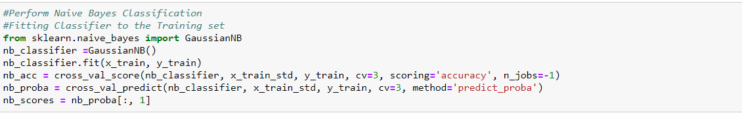
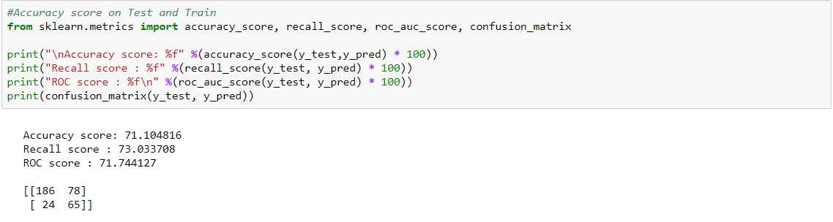
Naïve Bayes
Naïve Bayes classifiers are a family of simple "probabilistic classifiers" based on applying Bayes' theorem with strong independence assumptions between the features. They are among the simplest Bayesian network models.

Slide 11
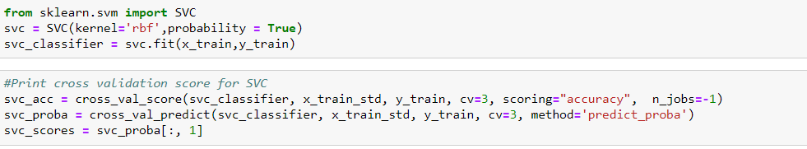

SVM
SVM algorithm is to create the best line or decision boundary that can segregate n-dimensional space into classes so that we can easily put the new data point in the correct category in the future. This best decision boundary is called a hyperplane.

Slide 12
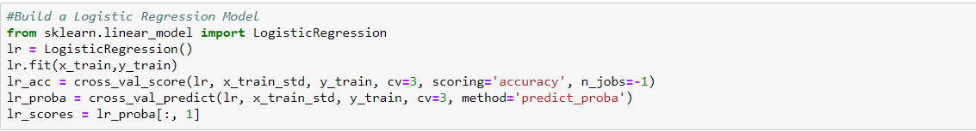
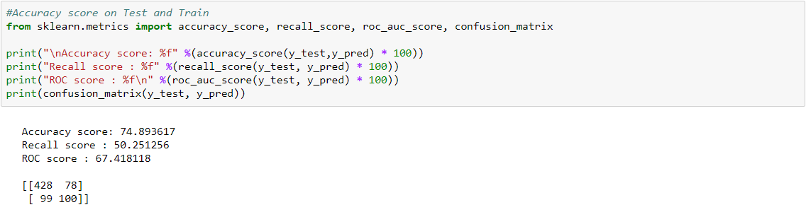
Logistic Regression
Logistic regression is a supervised learning classification algorithm used to predict the probability of a target variable. The nature of target or dependent variable is dichotomous, which means there would be only two possible classes.

Slide 13
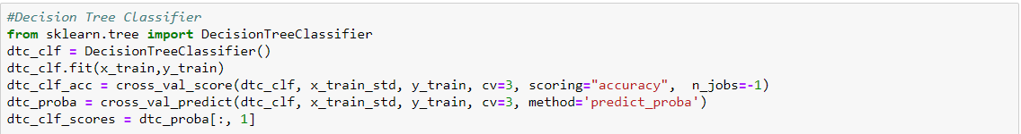
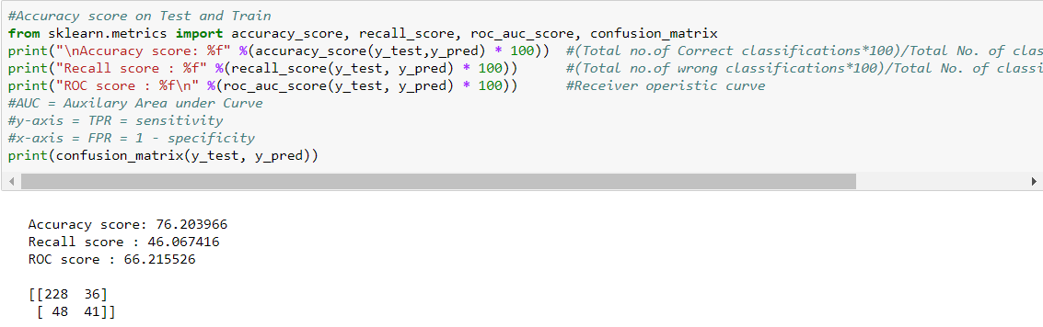
Decision tree
Decision tree uses the tree representation to solve the problem in which each leaf node corresponds to a class label and attributes are represented on the internal node of the tree.

Slide 14
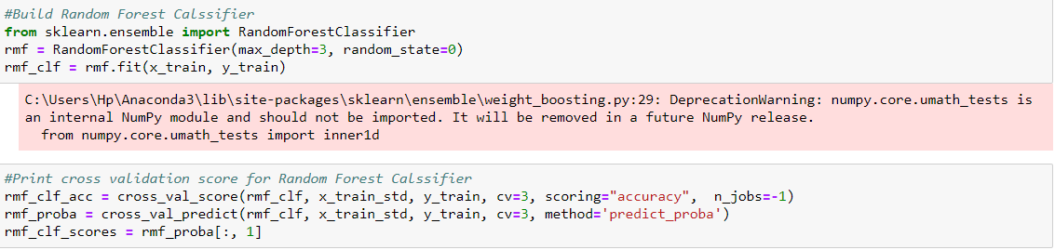
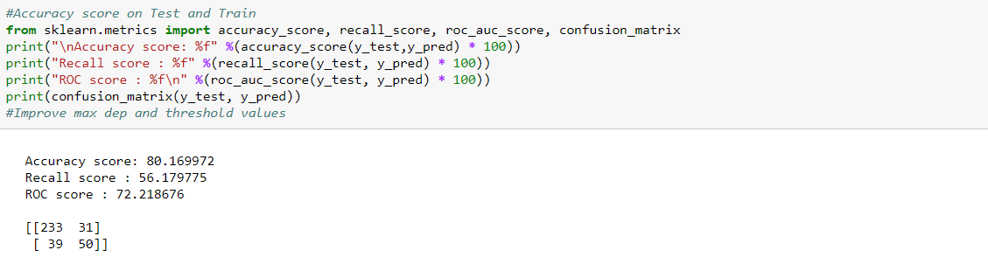
Random forest
Random forest algorithm creates decision trees on data samples and then gets the prediction from each of them and finally selects the best solution by means of voting. It is an ensemble method which is better than a single decision tree because it reduces the over-fitting by averaging the result.

Slide 15
definitions
Accuracy: Ratio of number of correct predictions to the total number of input samples.
Recall: Ratio of number of correct positive results divided by the number of all relevant samples (all samples that should have been identified as positive).
ROC: The ROC curve is a graph with: The x-axis showing 1 – specificity (= false positive fraction = FP/(FP+TN)) The y-axis showing sensitivity (= true positive fraction = TP/(TP+FN))

Slide 16
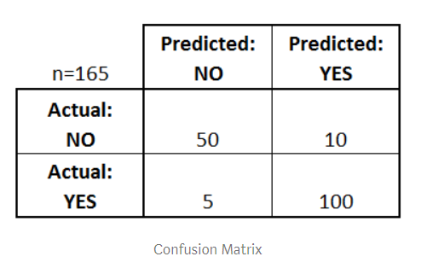
Confusion matrix
There are 4 important terms :
True Positives : The cases in which we predicted YES and the actual output was also YES.
True Negatives : The cases in which we predicted NO and the actual output was NO.
False Positives : The cases in which we predicted YES and the actual output was NO.
False Negatives : The cases in which we predicted NO and the actual output was YES.

Slide 17
comparisions
Accuracy Score
Recall Score
ROC Score

Slide 18
Table
Highest: Red
Least: Blue
 | ACCURACY | RECALL | ROC
KNN | 77.33 | 51.45 | 69.72
Naïve Bayes | 71.10 | 73.03 | 71.74
SVM | 81.01 | 47.19 | 69.80
Logistic Regression | 74.89 | 50.25 | 67.41
Decision Tree | 76.20 | 46.06 | 66.21
Random Forest | 80.16 | 56.17 | 72.21

Slide 19
accuracy
Highest Accuracy is for SVM Classifier.
Random Forest’s accuracy is also high.
Naïve Bayes has the least accuracy.

Slide 20
Recall score
Highest Recall score is for Naïve Bayes Classifier.
Decision Tree has the least recall score.

Slide 21
ROC Score
Highest ROC score is for Random Forest Classifier.
Naïve Bayes ROC score is also high.
Decision Tree has the least ROC score.

Slide 22
Thank you : )

